Slide 1
WebGPU Flowing Shallow Waves
2025 Fall CIS 565 Final Project
Milestone 1 Presentation
Qirui Fu Pavel Peev
Tianhong Zhou

Slide 2
Content
Project Overview
Implementation in Milestone 1
Simulation Part
Rendering Part
Work for next mileston

Slide 3
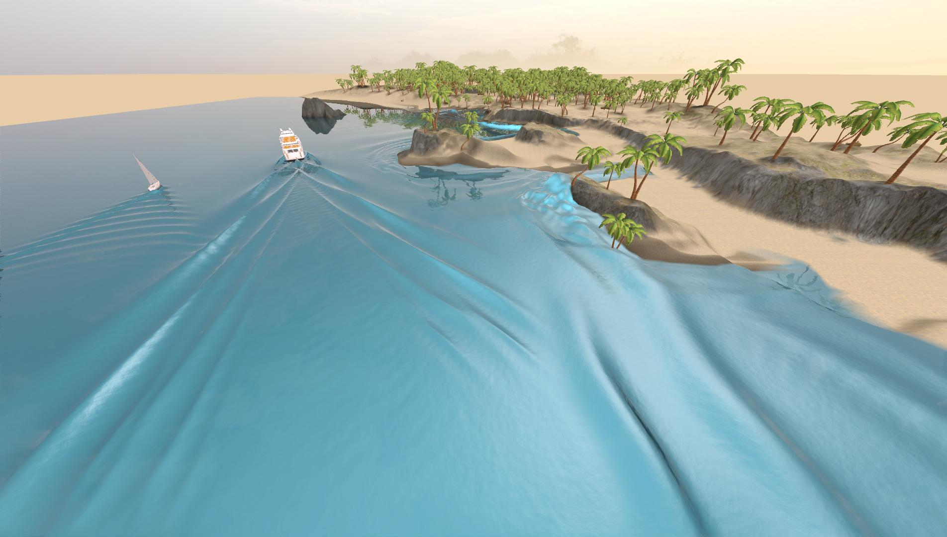
Project Overview
Reproduce Generalizing Shallow Water Simulation with Dispersive Surface Waves (SIGGRAPH 2023) model using WebGPU
Real-time, large-scale water wave propagation
Interactive control features
Generalizing Shallow Water Simulation with Dispersive Surface Waves (Stefan Jeschke and Chris Wojtan)

Slide 4
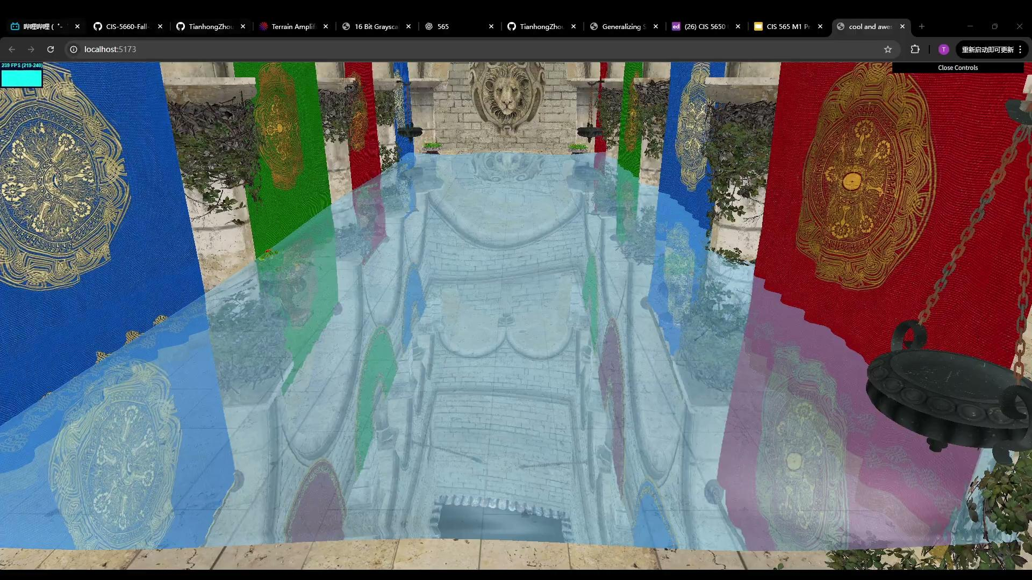
Milestone 1 Demo

Slide 5
Simulation
Created the simulation pipeline
Just like the renderer classes, what we need to do is implementing the class Simulator and its method functions.
Divided simulation process into 4 steps.
Implemented Decomposition.

Slide 6
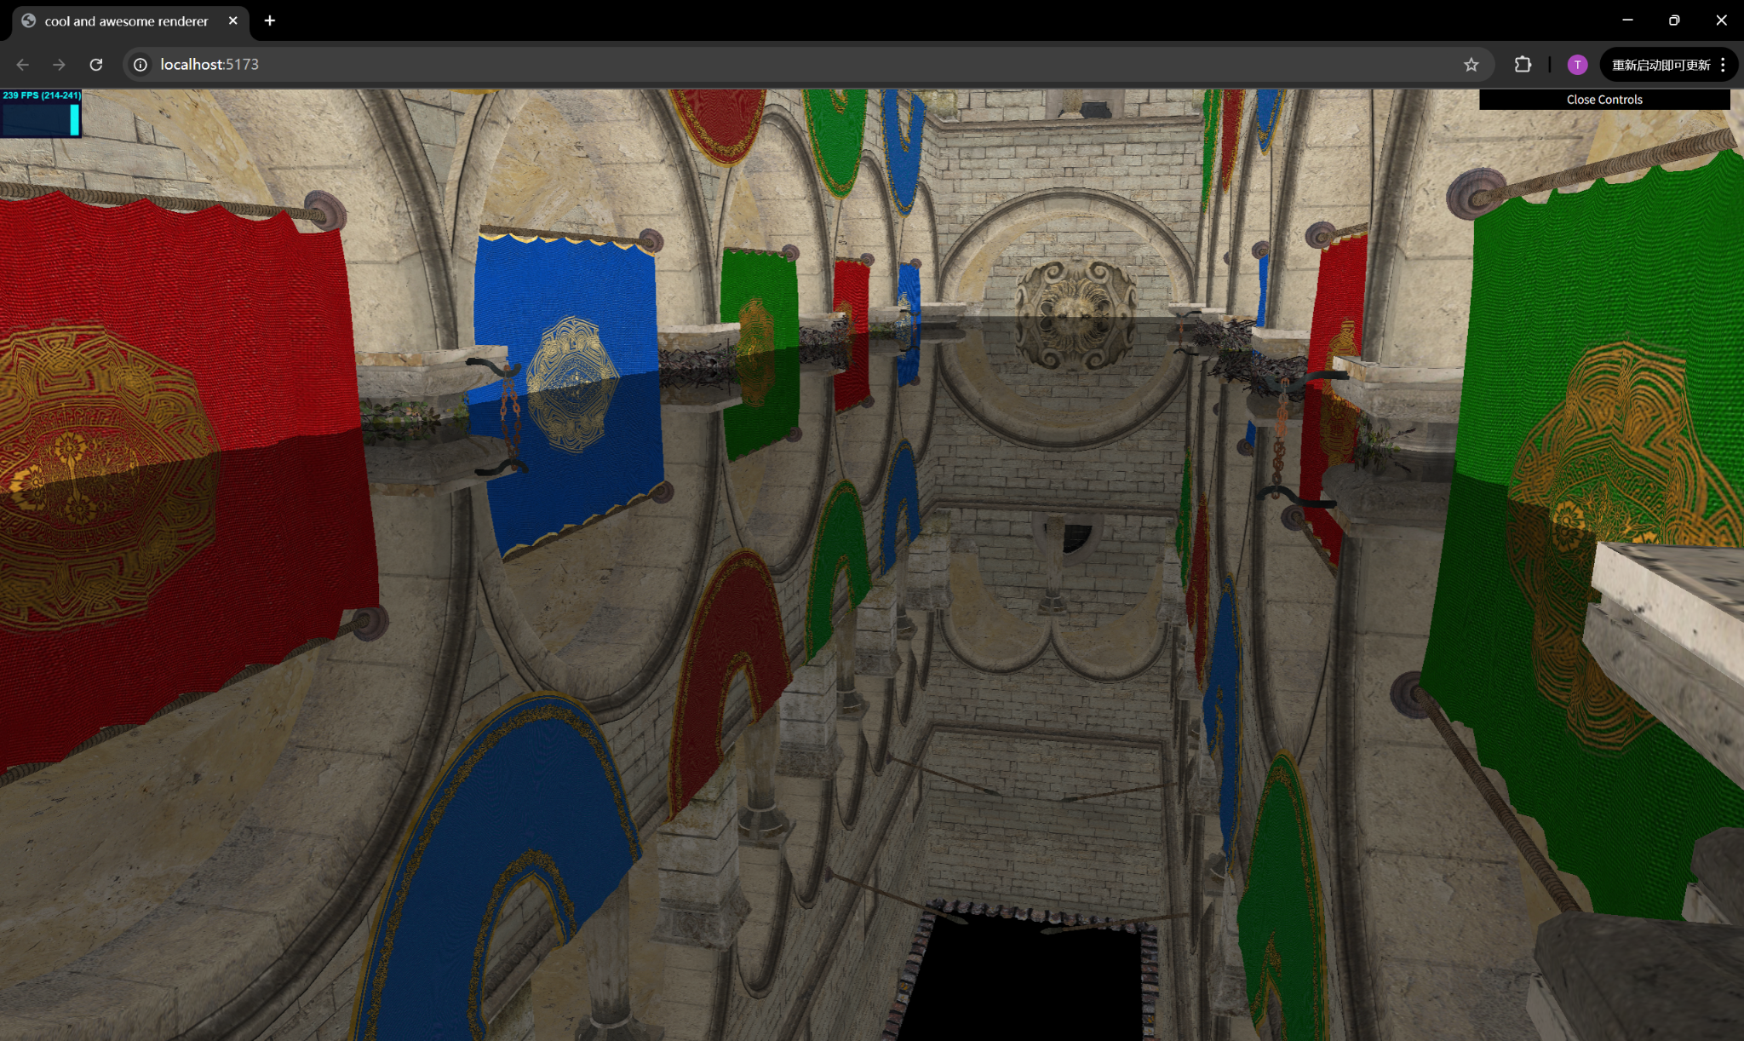
Rendering
Semi-transparent water rendering with alpha blending.
Planar reflection on the water surface using a mirrored camera.
Planar Reflection
Normal Distortion + Reflection + Semi-transparent

Slide 7
Work for future milestones
Simulation
Finish reproducing the paper
4 steps for simulation process
Implement FFT
Interactivity
Obj loader
Terrain-wave interaction
Rendering
Implement refraction
Add Fresnel-based lighting to enhance reflectance variation with viewing angle
Introduce skybox and environment mapping to enrich reflected scene detail
Add FFT wavelets

